Slide 1
Housing Project
Submitted by: Harshita Panchamia
Batch : Internship 25

Slide 2
Housing Project : Price Prediction
Houses are one of the necessary need of each and every person around the globe and therefore housing and real estate market is one of the markets which is one of the major contributors in the world’s economy. It is a very large market and there are various companies working in the domain.
Data science comes as a very important tool to solve problems in the domain to help the companies increase their overall revenue, profits, improving their marketing strategies and focusing on changing trends in house sales and purchases. Predictive modelling, Market mix modelling, recommendation systems are some of the machine learning techniques used for achieving the business goals for housing companies. Our problem is related to one such housing company.
A US-based housing company named Surprise Housing has decided to enter the Australian market. The company uses data analytics to purchase houses at a price below their actual values and flip them at a higher price. For the same purpose, the company has collected a data set from the sale of houses in Australia. The company is looking at prospective properties to buy houses to enter the market. You are required to build a model using Machine Learning in order to predict the actual value of the prospective properties and decide whether to invest in them or not.
For this company wants to know:
• Which variables are important to predict the price of variable?
• How do these variables describe the price of the house?

Slide 3
Technical Requirements
Data contains 1460 entries each having 81 variables.
Data contains Null values. You need to treat them using the domain knowledge and your own understanding.
Extensive EDA has to be performed to gain relationships of important variable and price.
Data contains numerical as well as categorical variable. You need to handle them accordingly.
You have to build Machine Learning models, apply regularization and determine the optimal values of Hyper Parameters.
You need to find important features which affect the price positively or negatively.
Two datasets are being provided to you (test.csv, train.csv). You will train on train.csv dataset and predict on test.csv file.

Slide 4
Data Preprocessing
This data has many null values present in it, which cannot be processed. Also, there are lots of variables labelled as NaN, but they are actually not null values and they have a certain meaning,
For Example,
• NA in feature 'Alley' means No_Alley
• In case of PoolQC, NA means 'No Pool'
I've replaced them with actual variables.
After treating the null values, I found that there’s some kind of
order present in the data, hence it is ordinal in nature. And replaced the ordinal data with numeric one by using OrdinalEncoder and labelEncoder.

Slide 5
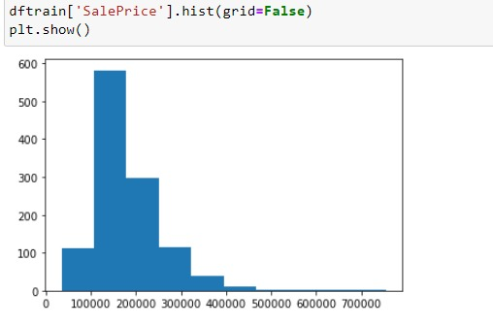
EDA and Data Visualizations
755000 is the max value of sales price

Slide 6
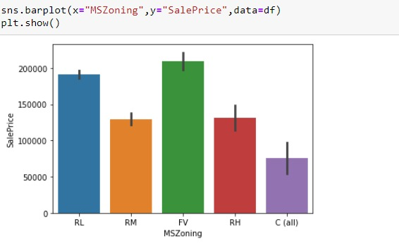
EDA and Data Visualizations
Floating Village Residential (FV) has the higher value of sales

Slide 7
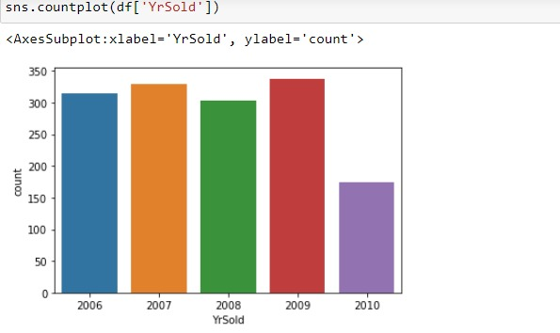
EDA and Data Visualizations
Year 2009 has the maximum number of sales

Slide 8
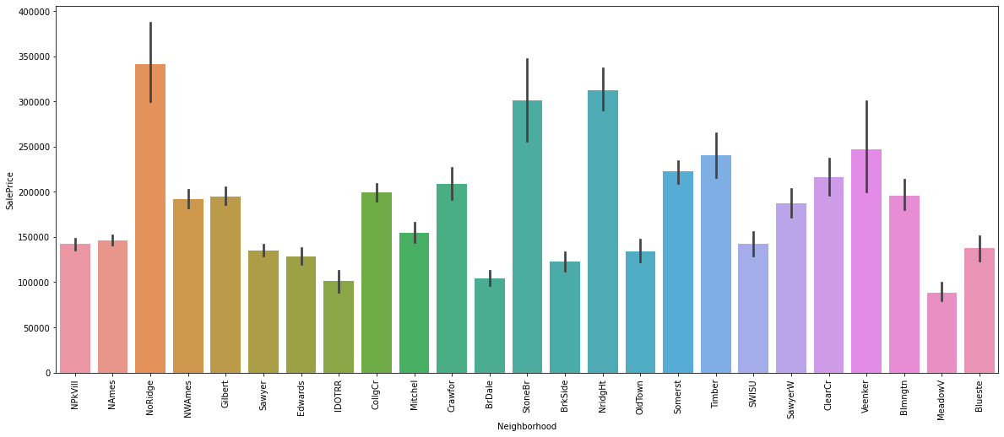
EDA and Data Visualizations
North Ridge is in the Physical locations within Ames city limits has the higher count of saleprice

Slide 9
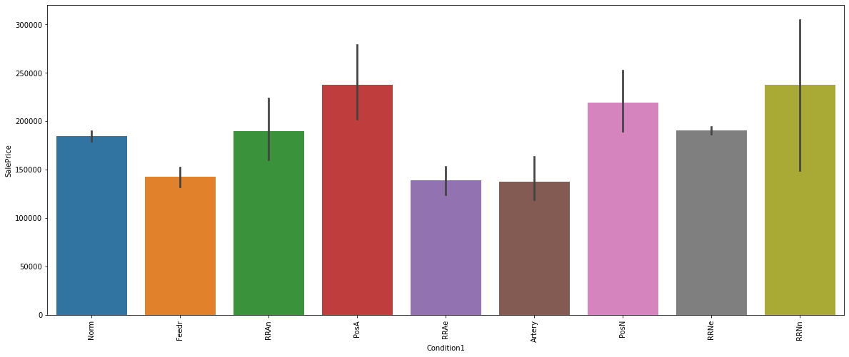
EDA and Data Visualizations
PosA Adjacent to postive off-site feature RRNe Within 200' of East-West Railroad these are the two most valued Proximity to various conditions

Slide 10
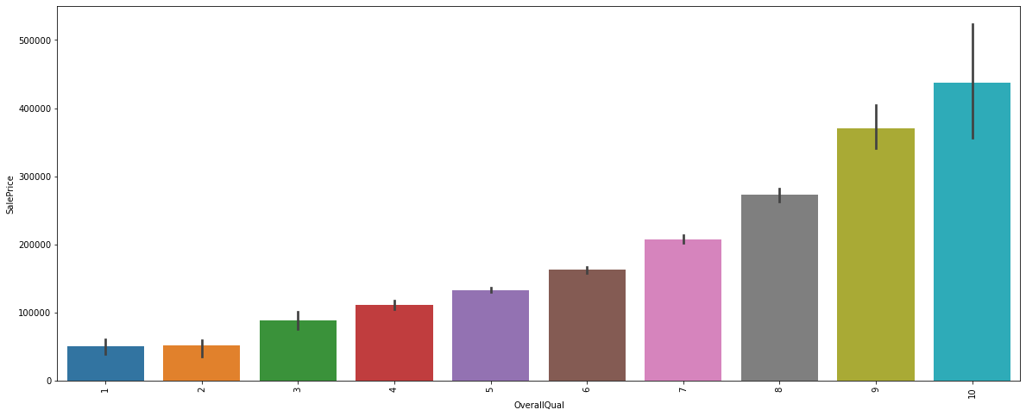
EDA and Data Visualizations
Very Excellent class value has the higher quality and hence higher price values. and the graph shows the slope as the quality increases the Sales Price increases.

Slide 11
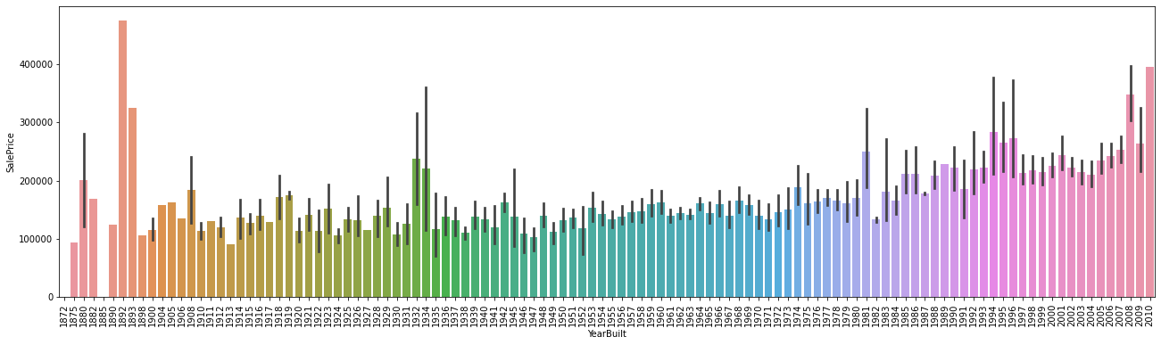
EDA and Data Visualizations
Year 2010 and year 1892 has the max price in sales .

Slide 12
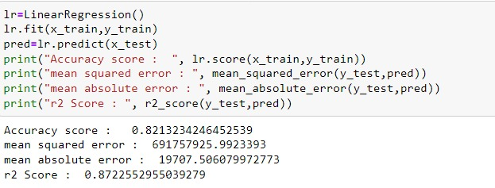
Linear Regressor Model

Slide 13
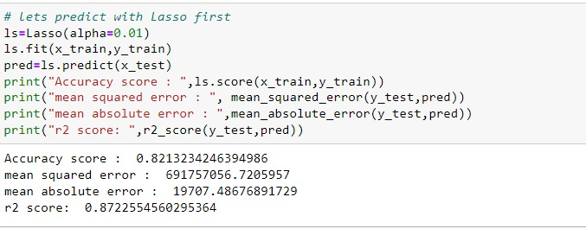
Lasso Regressor

Slide 14
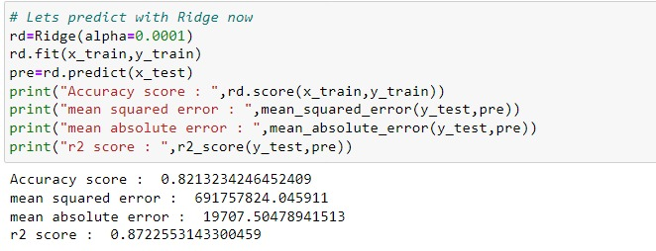
Ridge Regressor

Slide 15
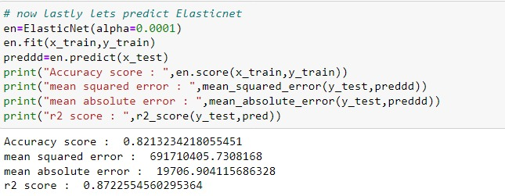
ElasticNet Regressor

Slide 16
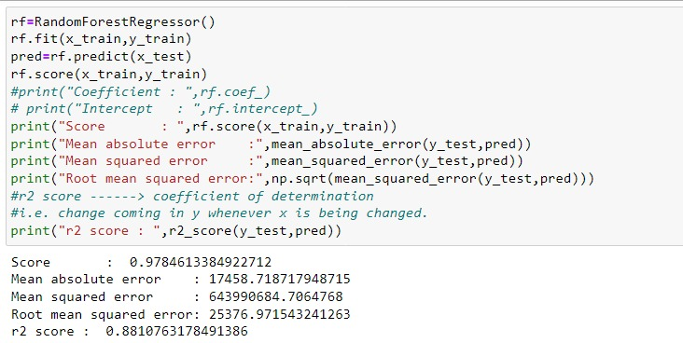
Random Forest Regressor

Slide 17
Gradient Boosting Regressor

Slide 18
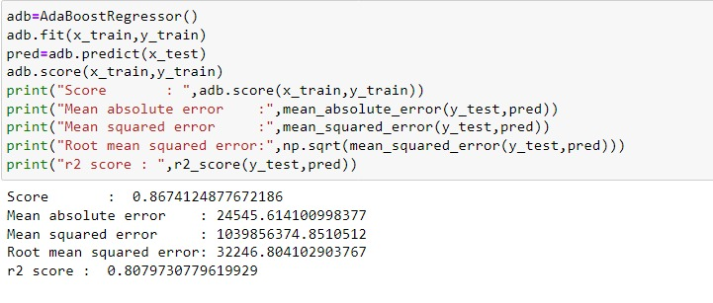
AdaBoost Regressor

Slide 19
Conclusion
MS Sub Class seems to have the biggest impact on House Prices,followed by Basement Full Bath and Basement Half Bath
Other than the Basement related features, Condition 2, Exterior Quality and Lot Area are some of the other important features.
Learning Outcomes of the Study in respect of Data Science.
All transformation must be done after splitting the data to test and train, otherwise the parameters are affected.

Slide 20
Limitations of this work and Scope for Future Work
The biggest limitation I observed was that not all categories of a particular feature were available in the training data.
So, if there is a new category in the test data/new data, the model would not be able to identify the new categories

